Slide 1
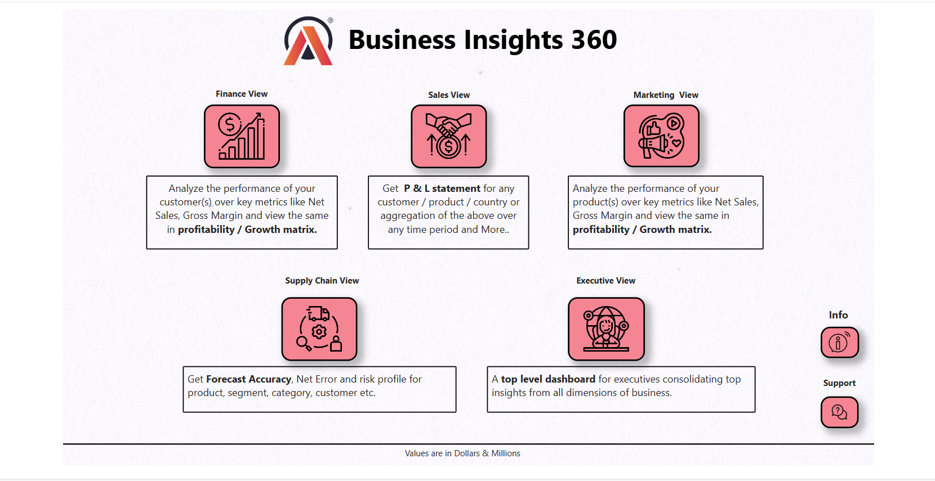

pawan-yadav-data

Slide 2
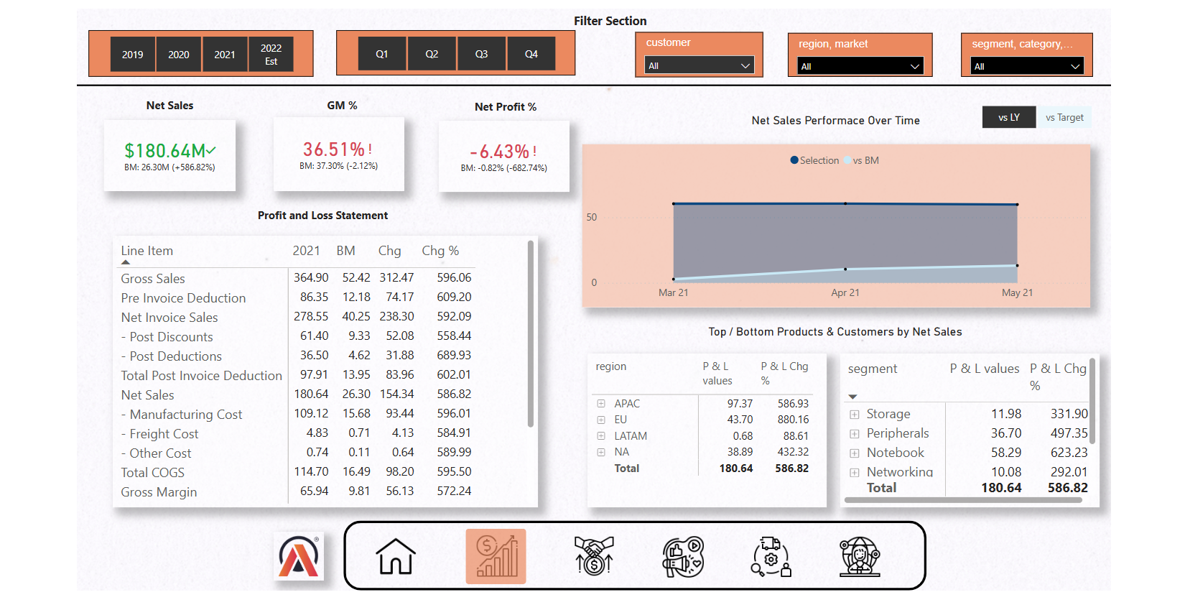
pawan-yadav-data

Slide 3
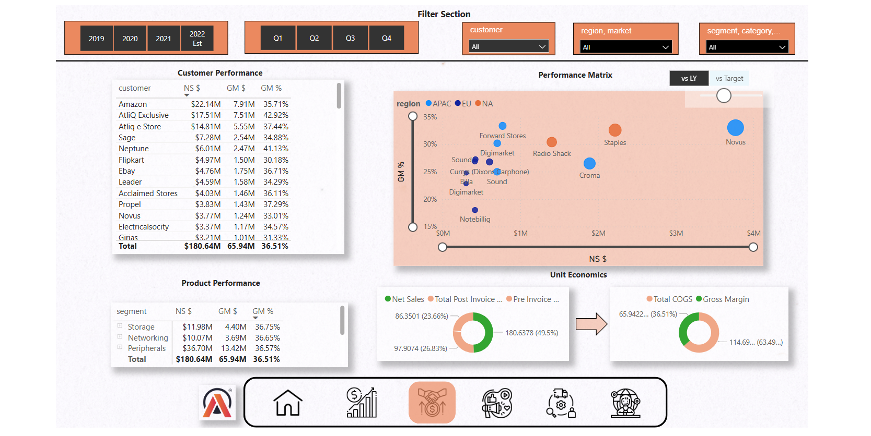
pawan-yadav-data

Slide 4
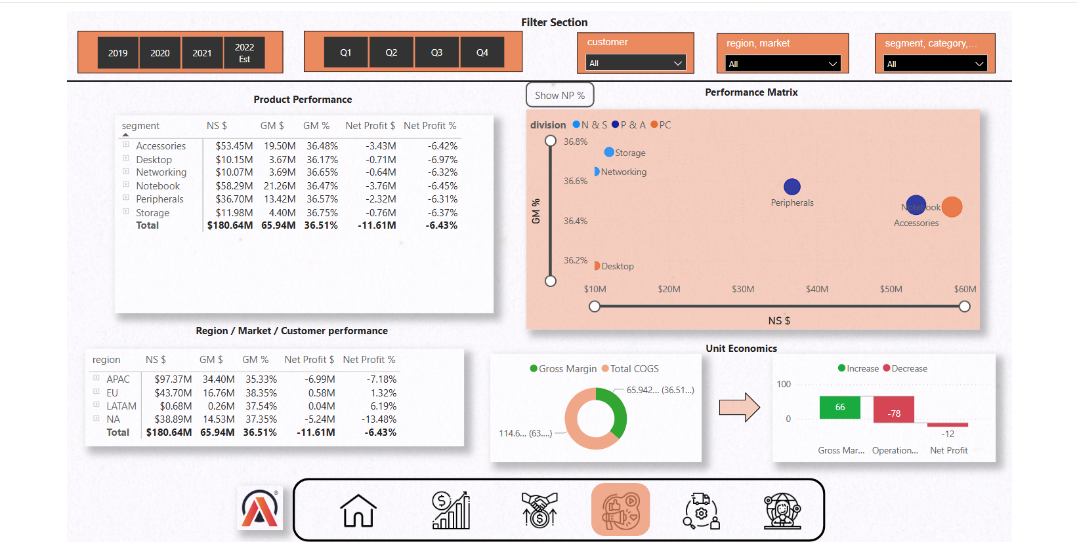
pawan-yadav-data

Slide 5
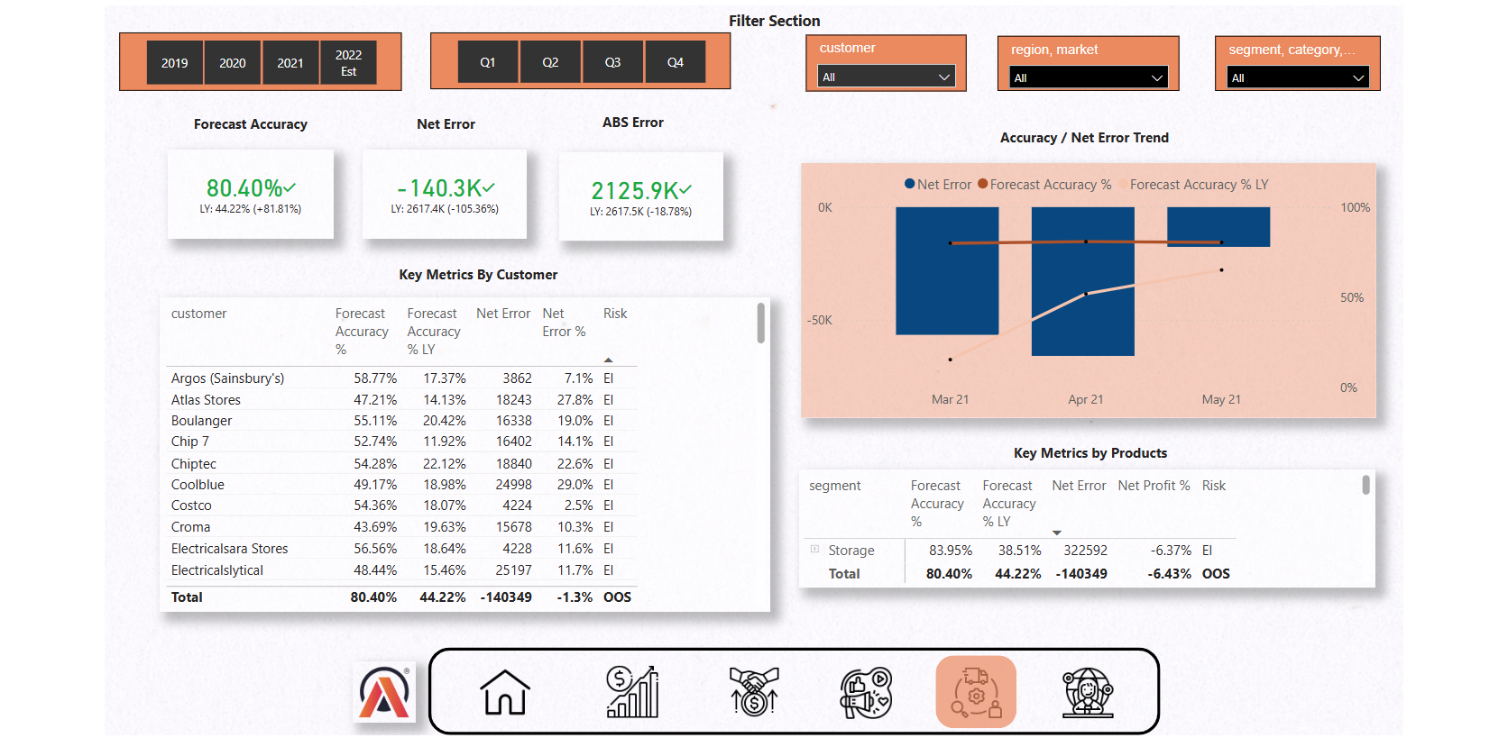
pawan-yadav-data

Slide 6
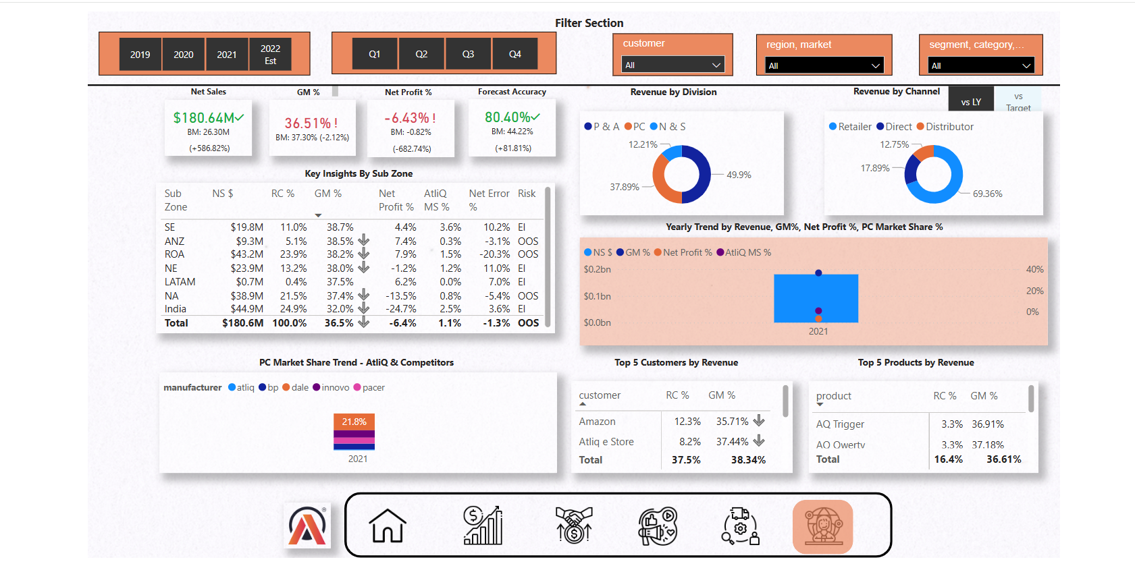
pawan-yadav-data

Slide 7
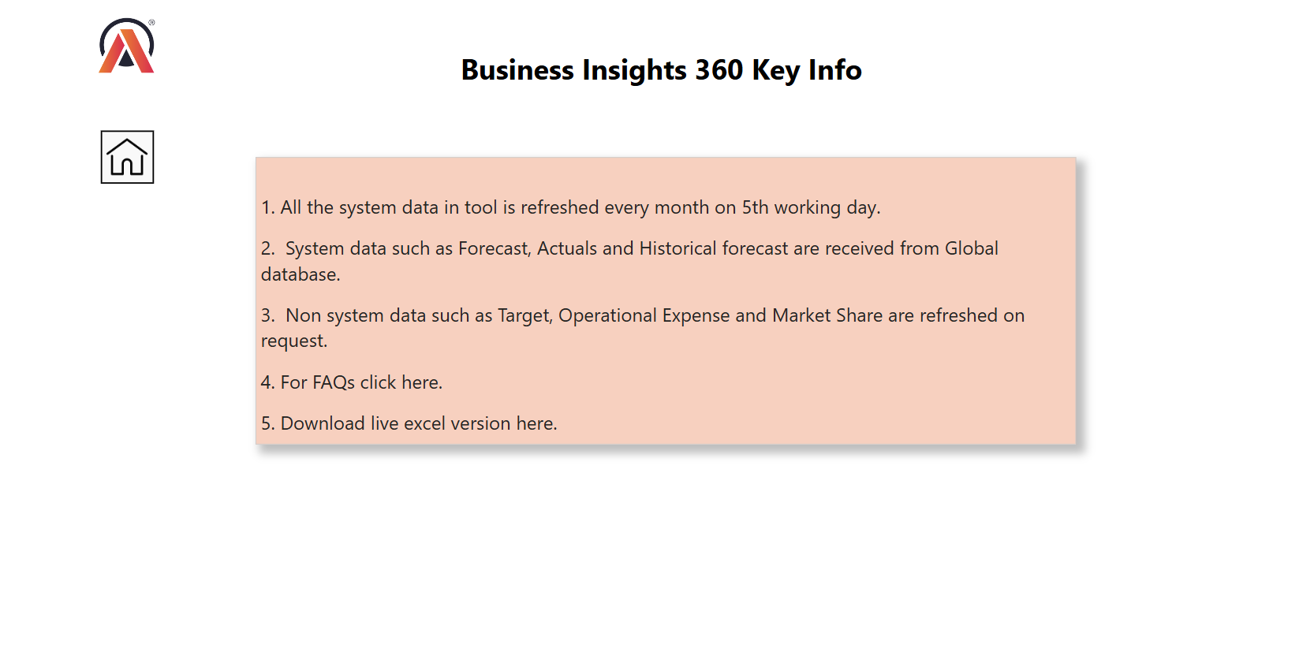
pawan-yadav-data

Slide 8
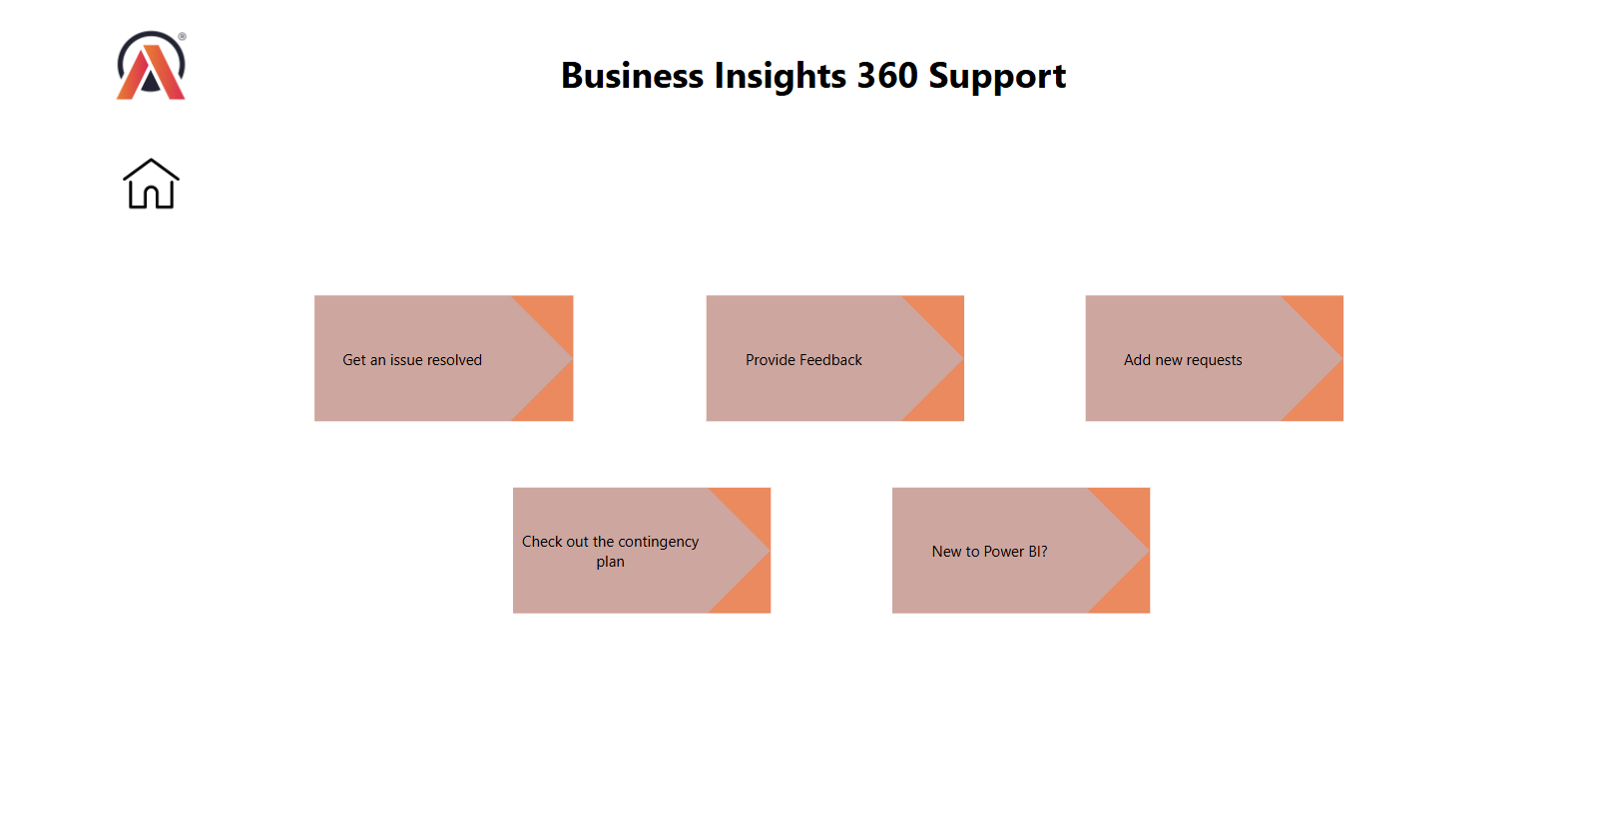
pawan-yadav-data

